Slide 1
Cloud Computing – CSE4001
Course Instructor: Dr. Arunkumar Gopu
Senior Assistant Professor – Grade I
School of Computer Science and Engineering (SCOPE)
VIT – AP University, Amaravati, Andhra Pradesh.
Email-id: arunkumar.gopu@vitap.ac.in

Slide 2
Module 5
Cloud Delivery Model Considerations
Cloud Delivery Model Considerations: The cloud provider perspective Building IaaS environments, equipping PaaS environments, optimizing SaaS environments, the cloud consumer perspective, working with IaaS environments, working with PaaS environments, working with SaaS services.

Slide 3
Cloud Delivery Models: The Cloud Provider Perspective
This module explores the architecture and administration of IaaS, PaaS, and SaaS cloud delivery models from the point of view of the cloud provider.
The integration and management of these cloud-based environments as part of greater environments and how they can relate to different technologies and cloud mechanism combinations are examined.

Slide 4
Building IaaS Environments
The virtual server and cloud storage device mechanisms represent the two most fundamental IT resources that are delivered as part of a standard rapid provisioning architecture within IaaS environments.
Operating system
Primary memory capacity
Processing capacity
Virtualized storage capacity

Slide 5
Building IaaS Environments
Memory and virtualized storage capacity is usually allocated with increments of 1 GB to simplify the provisioning of underlying physical IT resources.
IaaS offerings are pre-emptively assembled by cloud providers via virtual server images that capture the pre-defined configurations.
Bare-metal provisioning architecture.
Snapshots can be taken of a virtual server to record its current state, memory, and configuration of a virtualized IaaS environment.

Slide 6
Building IaaS Environments
The snapshot can be used to duplicate a virtual server.
Most cloud providers also support importing and exporting options for custom-built virtual server images in both proprietary and standard formats.

Slide 7
Data Centers
Cloud providers can offer IaaS-based IT resources from multiple geographically diverse data centers, which provides the following primary benefits:
Multiple data centers can be linked together for increased resiliency.
Each data center is placed in a different location to lower the chances of a single failure forcing all of the data centers to go offline simultaneously.
Connected through high-speed communications networks with low latency.

Slide 8
Data Centers
Data centers can perform load balancing, IT resource backup and replication, and increase storage capacity, while improving availability and reliability.
Having multiple data centers spread over a greater area further reduces network latency.
Data centers that are deployed in different countries make access to IT resources more convenient for cloud consumers that are constricted by legal and regulatory requirements.

Slide 9
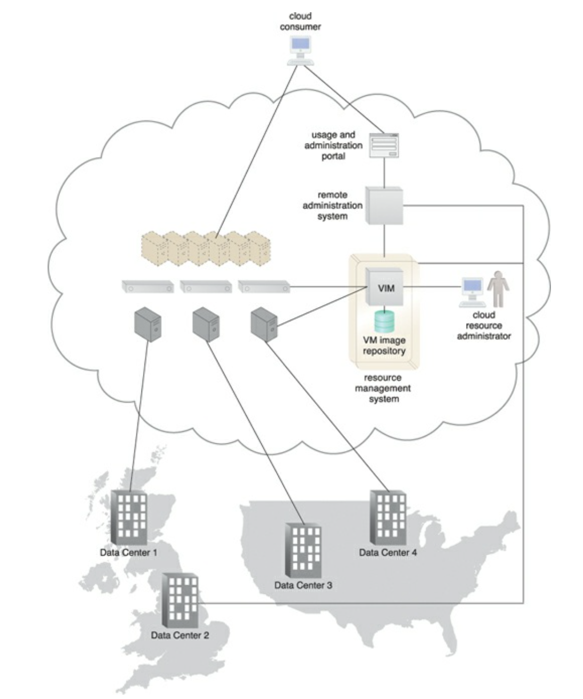
Data Centers

Slide 10
Data Centers
When an IaaS environment is used to provide cloud consumers with virtualized network environments.
Each cloud consumer is segregated into a tenant environment that isolates IT resources from the rest of the cloud through the Internet.
VLANs and network access control software collaboratively realize the corresponding logical network perimeters.

Slide 11
Scalability and Reliability
Within IaaS environments, cloud providers can automatically provision virtual servers via the dynamic vertical scaling type of the dynamic scalability architecture.
This can be performed through the VIM, if the host physical servers have sufficient capacity.
The VIM can scale virtual servers out using resource replication as part of a resource pool architecture, if a given physical server has insufficient capacity to support vertical scaling.

Slide 12
Scalability and Reliability
The load balancer mechanism, as part of a workload distribution architecture, can be used to distribute the workload among IT resources in a pool to complete the horizontal scaling process.
Manual scalability requires the cloud consumer to interact with a usage and administration program to explicitly request IT resource scaling.
Automatic scalability requires the automated scaling listener to monitor the workload and reactively scale the resource capacity.

Slide 13
Scalability and Reliability
This mechanism typically acts as a monitoring agent that tracks IT resource usage in order to notify the resource management system when capacity has been exceeded.
Replicated IT resources can be arranged in high-availability configuration that forms a failover system for implementation via standard VIM features.
Alternatively, a high- availability/high-performance resource cluster can be created at the physical or virtual server level, or both simultaneously.

Slide 14
Scalability and Reliability
The multipath resource access architecture is commonly employed to enhance reliability via the use of redundant access paths.
Some cloud providers further offer the provisioning of dedicated IT resources via the resource reservation architecture.

Slide 15
Monitoring
Cloud usage monitors in an IaaS environment can be implemented using the VIM.
Virtual Server Lifecycles–Recording and tracking uptime periods and the allocation of IT resources, for pay-per-use monitors and time-based billing purposes.
Data Storage–Tracking and assigning the allocation of storage capacity to cloud storage devices on virtual servers, for pay-per-use monitors that record storage usage for billing purposes.

Slide 16
Monitoring
Network Traffic–For pay-per-use monitors that measure in bound and outbound network usage and SLA monitors that track QoS metrics, such as response times and network losses.
Failure Conditions–For SLA monitors that track IT resource and QoS metrics to provide warning in times of failure.
Event Triggers – For audit monitors that appraise and evaluate the regulatory compliance of select IT resources.

Slide 17
Security
Cloud security mechanisms that are relevant for securing IaaS environments include:
Encryption, hashing, digital signature, and PKI mechanisms for overall protection of data transmission.
IAM and SSO mechanisms for accessing services and interfaces in security systems that rely on user identification, authentication, and authorization capabilities.
Cloud based security groups for isolating virtual environments through hypervisors and network segments via network management software.

Slide 18
Security
Hardened virtual server images for internal and externally available virtual server environments
Various cloud usage monitors to track provisioned virtual IT resources to detect abnormal usage patterns

Slide 19
Equipping PaaS Environments
PaaS environments is typically is application development and deployment platforms in order to accommodate different programming models, languages, and frameworks.
A separate ready-made environment is usually created for each programming stack that contains the necessary software to run applications.
Each platform is accompanied by a matching SDK and IDE, which can be custom-built or enabled by IDE plugins supplied by the cloud provider.
IDE toolkits can simulate the cloud runtime locally within the PaaS environment and usually include executable application servers.

Slide 20
Equipping PaaS Environments
The security restrictions that are inherent to the runtime are also simulated in the development environment, including checks for unauthorized attempts to access system IT resources.
Cloud consumers can create and control customized virtual server images with ready-made environments.
This mechanism also provides features specific to the PaaS platform, such as managing deployed applications and configuring multitenancy.

Slide 21
Scalability and Reliability
The scalability requirements of PaaS environments are generally addressed via dynamic scalability and workload distribution architectures.
That rely on the use of native automated scaling listeners and load balancers.
The resource pooling architecture is further utilized to provision IT resources from resource pools made available to multiple cloud consumers.

Slide 22
Scalability and Reliability
Cloud providers can evaluate network traffic and server-side connection usage against the instance’s workload.
The reliability of ready-made environments and hosted cloud services and applications can be supported with standard failover system mechanisms
Non-disruptive service relocation architecture, to shield cloud consumers from failover conditions.
The resource reservation architecture may also be in place to offer exclusive access to PaaS-based IT resources

Slide 23
Monitoring
Specialized cloud usage monitors in PaaS environments are used to monitor the following:
Ready-Made Environment Instances – The applications of these instances are recorded by pay-per-use monitors for the calculation of time-based usage fees.
Data Persistence – This statistic is provided by pay-per-use monitors that record the number of objects, individual occupied storage sizes, and database transactions per billing period.

Slide 24
Monitoring
Network Usage–Inbound and outbound network usage is tracked for pay-per-use monitors and SLA monitors that track network-related QoS metrics.
Failure Conditions–SLA monitors that track the QoS metrics of IT resources need to capture failure statistics.
Event Triggers – This metric is primarily used by audit monitors that need to respond to certain types of events.

Slide 25
Security
The PaaS environment, by default, does not usually introduce the need for new cloud security mechanisms beyond those that are already provisioned for IaaS environments.

Slide 26
Optimizing SaaS Environments
In SaaS implementations, cloud service architectures are generally based on multitenant environments that enable concurrent cloud consumer access.
SaaS IT resource segregation does not typically occur at the infrastructure level.
SaaS implementations rely heavily on the features provided by the native dynamic scalability and workload distribution architectures.
Non-disruptive service relocation to ensure that failover conditions do not impact the availability of SaaS-based cloud services.

Slide 27
Optimizing SaaS Environments
SaaS deployment will bring with it unique architectural, functional, and runtime requirements.
These requirements are specific to the nature of the business logic the SaaS-based cloud service is programmed with, as well as the distinct usage patterns it is subjected to by its cloud service consumers.
For example, consider the diversity in functionality and usage of the following recognized online SaaS offerings:
Collaborative authoring and information-sharing (Wikipedia, Blogger)
Collaborative management(Zimbra, Google Apps)
Audio/video communications(Skype, Google Meet)

Slide 28
Optimizing SaaS Environments
Consider that many of the previously listed cloud services are offered in one or more of the following implementation mediums:
Mobile Application
REST service
Webservice
Mobile-enabled SaaS implementations are commonly supported by the multi-device broker mechanism.

Slide 29
Optimizing SaaS Environments
Service Load Balancing–for workload distribution across redundant SaaS-based cloud service implementations
Dynamic Failure Detection and Recovery–To establish a system that can automatically resolve some failure conditions without disruption in service to the SaaS implementation
Storage Maintenance Window–to allow for planned maintenance outages that do not impact SaaS implementation availability
Elastic Resource Capacity/Elastic Network Capacity–to establish inherent elasticity within the SaaS-based cloud service architecture that enables it to automatically accommodate a range of runtime scalability requirements

Slide 30
Optimizing SaaS Environments
Cloud Balancing–To in still broad resiliency within the SaaS implementation, which can be especially important for cloud services subjected to extreme concurrent usage volumes
Specialized cloud usage monitors can be used in SaaS environments to track the following types of metrics:
Tenant Subscription Period–This metric is used by pay-per-use monitors to record and track application usage for time-based billing.
Application Usage – This metric, based on user or security groups, is used with pay- per-use monitors to record and track application usage for billing purposes.

Slide 31
Optimizing SaaS Environments
Tenant Application Functional Module – This metric is used by pay-per-use monitors for function-based billing.
Cloud services can have different functionality tiers according to whether the cloud consumer is free-tier or a paid subscriber.
SaaS environments are also commonly monitored for data storage, network traffic, failure conditions, and event triggers.

Slide 32
Security
SaaS implementations generally rely on a foundation of security controls inherent to their deployment environment.
Distinct business processing logic will then add layers of additional cloud security mechanisms or specialized security technologies.

Slide 33
The Cloud Consumer Perspective: Working with IaaS
Virtual servers are accessed at the operating system level using remote terminal applications.
Remote Desktop Client – for Windows based environments and presents a Windows GUI desktop
SSH Client – for Mac and other Linux based environments to allow for secure channel connections to text-based shell accounts running on the server OS.

Slide 34
Working with IaaS
A cloud storage device can be attached directly to the virtual servers and accessed through the virtual servers’ functional interface for management by the operating system.
Alternatively, a cloud storage device can be attached to an IT resource that is being hosted outside of the cloud, such as an on-premise device over a WAN or VPN.
In these cases, the following formats for the manipulation and transmission of cloud storage data are commonly used:

Slide 35
Working with IaaS
Networked File System–System based storage access,whose rendering of files is like how folders are organized in operating systems (NFS, CIFS).
Storage Area Network Devices–Block-based storage access collates and formats geographically diverse data into cohesive files for optimal network transmission (iSCSI, Fibre Channel).
Web-Based Resources–Object-based storage access by which an interface that is not integrated into the operating system logically represents files, which can be accessed through a Web-based interface (Amazon S3)

Slide 36
Working with PaaS Environments
A typical PaaS IDE can offer a wide range of tools and programming resources, such as software libraries, class libraries, frameworks, APIs, and various runtime capabilities that emulate the intended cloud-based deployment environment.
These features allow developers to create, test, and run application code within the cloud or locally (on- premise) while using the IDE to emulate the cloud deployment environment.

Slide 37
Working with PaaS Environments
Compiled or completed applications are then bundled and uploaded to the cloud and deployed via the ready-made environments. This deployment process can also be controlled through the IDE.
PaaS also allows for applications to use cloud storage devices as independent data storing systems for holding development specific data (for example in a repository that is available outside of the cloud environment).
Both SQL and NoSQL database structures are generally supported.

Slide 38
Working with SaaS Environments
Because SaaS-based cloud services are almost always accompanied by refined and generic APIs, they are usually designed to be incorporated as part of larger distributed solutions.
A common example of this is Google Maps, which offers a comprehensive API that enables mapping information and images to be incorporated into Web sites and Web-based applications.
Many SaaS offerings are provided free of charge, although these cloud services often come with data collecting sub-programs that harvest usage data for the benefit of the cloud provider.

Slide 39
Working with SaaS Environments
When using any SaaS product that is sponsored by third parties, there is a reasonable chance that it is performing a form of background information gathering.
Reading the cloud provider’s agreement will usually help shed light on any secondary activity that the cloud service is designed to perform.
Cloud consumers using SaaS products supplied by cloud providers are relieved of the responsibilities of implementing and administering their underlying hosting environments.

Slide 40
Working with SaaS Environments
Customization options are usually available to cloud consumers; however, these options are generally limited to the runtime usage control of the cloud service instances that are generated specifically by and for the cloud consumer.

